Slide 1
Strings, StringBuilders
& Regular Expressions
Chapter 2 - Part 2

Slide 2
Contents
String class, constructors, properties, and methods
Stringbuilder class in C#
Regular Expressions

Slide 3

Strings in C#
A string is a series of characters treated as a single unit.
These characters can be uppercase letters, lowercase letters, digits and various special characters, such as +, -, *, /, $ and others.
A string is an object of class String in the System namespace.
A declaration can assign a string literal to a string reference. The declaration is as follows:

Slide 4
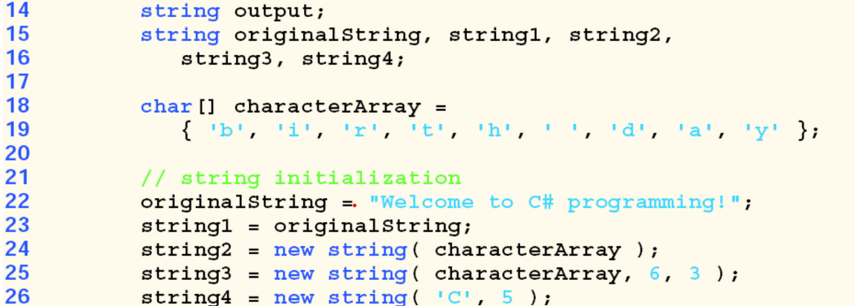
String Constructors
You can create strings with the various constructors provided by C#
birthday
day
CCCCC

Slide 5
Cont.
Line 24 assigns to string2 a new string, using the String constructor that takes a character array as an argument.
The new string contains a copy of the characters in array characterArray.
Line 25 assigns to string3 a new string, using the String constructor that takes a char array and two int arguments. The second argument specifies the starting index position (the offset) from which characters in the array are copied. The third argument specifies the number of characters (the count) to be copied from the specified starting position in the array.
Line 26 assigns to string4 a new string, using the String constructor that takes as arguments a character and an int specifying the number of times to repeat that character in the string.

Slide 6
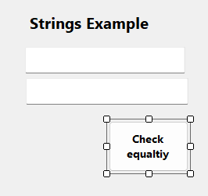
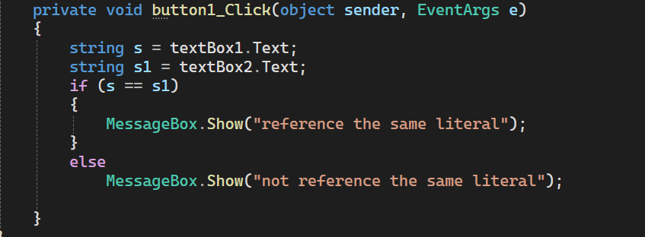
Cont.
Memory representation of strings
If there are multiple occurrences of the same string literal object in an application, a single copy of the string literal object will be located from each location in the program that uses the string literal. You can use the (==) or equals() to check if two string objects references the same string literal.

Slide 7
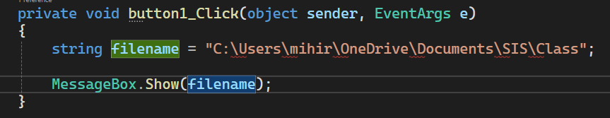
Verbatim String
Verbatim means "as is".
The @ special character serves as a verbatim identifier. You use it in the following ways:
To indicate that a string literal is to be interpreted verbatim. The @ character in this instance defines a verbatim string literal.
Example: the following line of code produces a syntax error indicating that there is an unrecognized escape sequence.

Slide 8
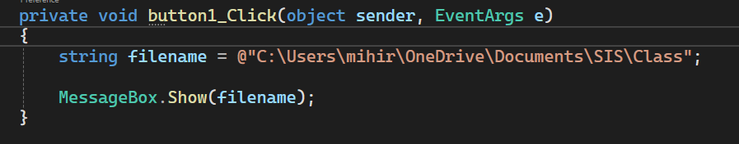
Cont.
Adding the verbatim @ character eliminates the problem

Slide 9
String Indexer, Length Property & CopyTo method
String indexer facilitates the retrieval of any character in the string,
The String property Length, returns the length of the string.
The String method CopyTo copies a specified number of characters from a string into a char array.
See examples on the following slides.

Slide 10
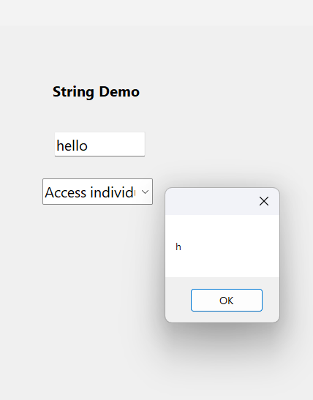
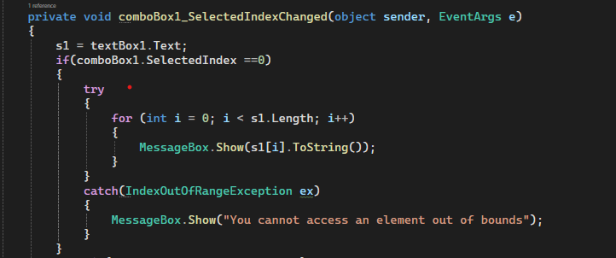
Demo App: Accessing each string element using Indexers

Slide 11
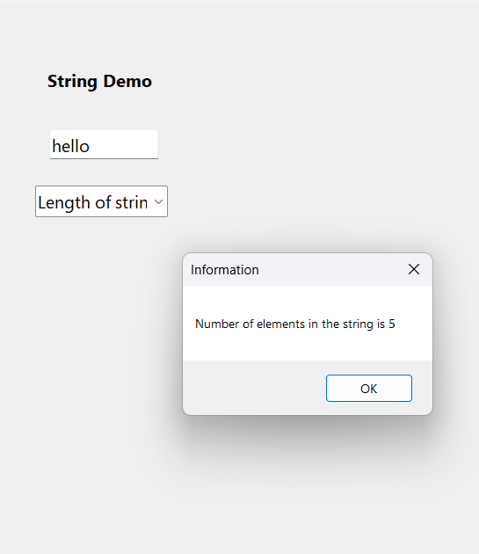
Using the Length Property of String

Slide 12
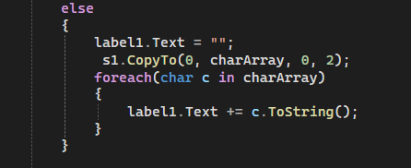
CopyTo() Method
The String method CopyTo copies a specified number of characters from a string into a char array. Assuming that a char array is declared outside of the combobox_indexchanged event handler.

Slide 13
Comparing Strings
C# provides various methods to compare Strings.
The process of comparing strings is akin to the system of alphabetizing a series of last names
You as a reader would place “Abebe” before “Kebede” because the first letter of “Abebe” comes before the letter of “Kebede” in the alphabet.
This indicates that the alphabet system is not just a collection of letters but also an ordered list of characters.
Therefore the letter “Z” is not just an letter in the alphabet: Z is specifically the 26th letter of the alphabet.
Computers can order characters alphabetically because the characters are represented internally as Unicode numeric codes. When comparing two strings, C# simply compares the numeric codes of the characters in the strings.

Slide 14
Comparing strings with Equals()
Method Equals (inherited by String from class Object) tests any two objects for equality (i.e., checks whether the objects contain identical contents).
The method returns true if the objects are equal and false otherwise.
Method Equals compares the numeric Unicode values that represent the characters in each string.
A comparison of the string "hello" with the string "HELLO" would return false, because the numeric representations of lowercase letters are different from the numeric representations of corresponding uppercase letters.

Slide 15
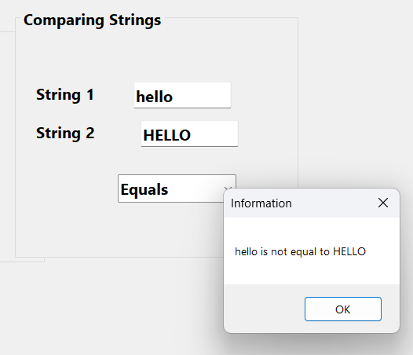
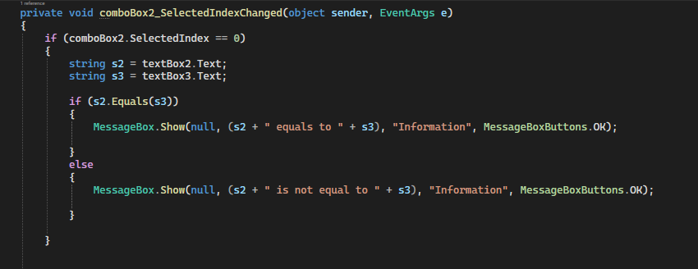
Demo App

Slide 16
Compare strings using CompareTo()
Another method for comparing methods is CompareTo().
CompareTo() class in C# compares two strings and returns an integer that indicates their relative order in terms of sorting.
Method CompareTo returns 0 if the strings are equal
-1 if the string that invokes CompareTo is less than the string that is passed as an argument
1 if the string that invokes CompareTo is greater than the string that is passed as an argument
Method CompareTo also uses a lexicographical comparison.

Slide 17
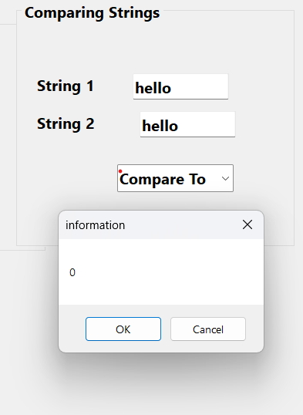
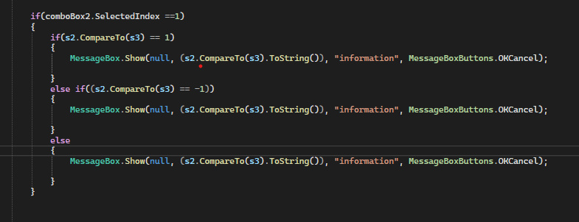
CompareTo() Demo

Slide 18
Methods StartsWith() & EndsWith()
The two methods shows how to test whether a string instance begins or ends with a given string.
Method StartsWith determines whether a string instance starts with the string text passed to it as an argument.
Method EndsWith determines whether a string instance ends with the string text passed to it as an argument.
The Methods return either true or false accordingly.

Slide 19
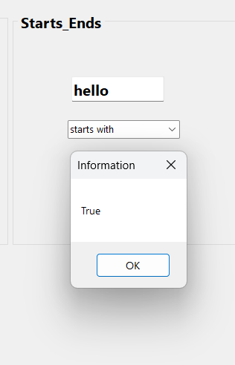
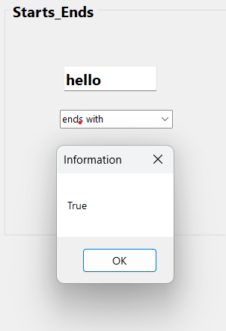
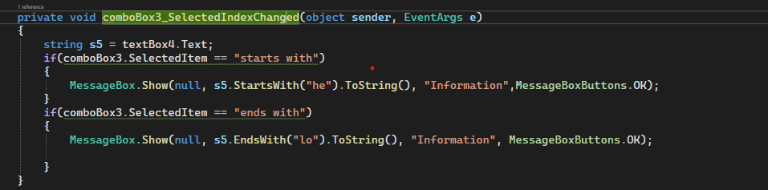
Demo App

Slide 20
Locating Strings and Substrings in Strings
In many applications, it is necessary to search for a character or set of characters in a string.
For example, a programmer creating a word processor would want to provide capabilities for searching through documents.
String methods IndexOf, IndexOfAny, LastIndexOf and LastIndexOfAny search for a specified character or substring in a string
IndexOf returns the index of the specified character in the string; otherwise, IndexOf returns –1.
IndexOf() has three overloaded versions.
IndexOf(char), IndexOf(char, startingindex<int>), IndexOf(char, startingindex<int>,no_of_chars<int>)

Slide 21
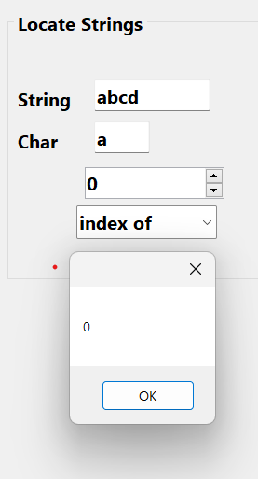
Demo App IndexOf(char)
private void comboBox4_SelectedIndexChanged(object sender, EventArgs e)
{
decimal index = numericUpDown1.Value;
char c = Convert.ToChar(textBox6.Text);
string s6 = textBox5.Text;
if(comboBox4.SelectedIndex ==0)
{
MessageBox.Show( s6.IndexOf(c).ToString());
}

Slide 22
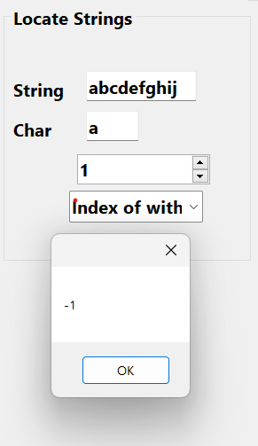
Demo App IndexOf(char, starting_index<int>)
if(comboBox4.SelectedIndex ==1)
{
MessageBox.Show(s6.IndexOf(c, 1).ToString());
}

Slide 23
LastIndexOf()
The method returns the index position of the last occurrence of a specified character or string within the given string.
If method LastIndexOf finds the character, LastIndexOf returns the index of the specified character in the string; otherwise, LastIndexOf returns –1.
There are three versions of LastIndexOf .
LastIndexOf that takes as an argument the character for which to search.
LastIndexOf that takes two arguments—the character for which to search and the highest index from which to begin searching backward for the character.
A third version of method LastIndexOf that takes three arguments— the character for which to search, the starting index from which to start searching backward and the number of characters (the portion of the string) t

Slide 24
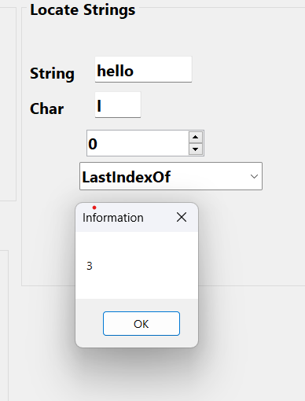
Demo App
private void comboBox4_SelectedIndexChanged(object sender, EventArgs e) {
decimal index = numericUpDown1.Value;
char c = Convert.ToChar(textBox6.Text);
string s6 = textBox5.Text;
if(comboBox4.SelectedIndex ==0) {
MessageBox.Show( s6.IndexOf(c).ToString());
}
if(comboBox4.SelectedIndex ==1) {
MessageBox.Show(s6.IndexOf(c, 1).ToString()); }
if (comboBox4.SelectedIndex ==3) {
MessageBox.Show(null, s6.LastIndexOf(c).ToString(),"Information",MessageBoxButtons.OK);
}

Slide 25
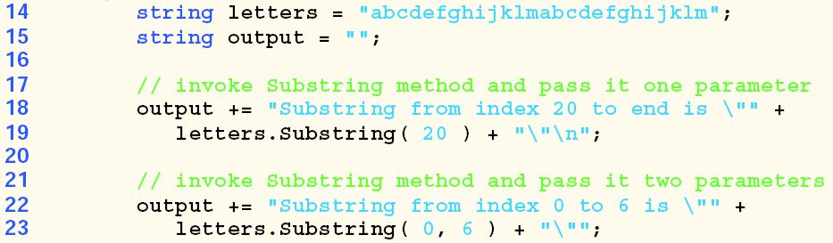
Extracting Substrings from Strings
Line 19 uses the Substring method that takes one int argument. The argument specifies the starting index from which the method copies characters in the original string.
The substring returned contains a copy of the characters from the starting index to the end of the string.

Slide 26
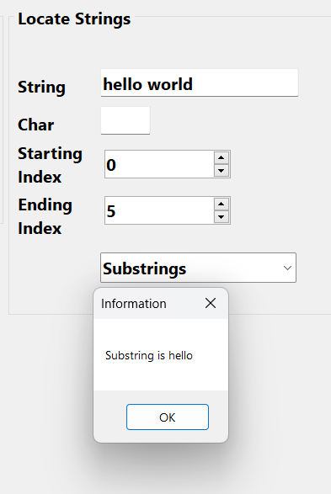
Demo
private void comboBox4_SelectedIndexChanged(object sender, EventArgs e)
{ int s_index = Convert.ToInt32(numericUpDown1.Value);
int e_index = Convert.ToInt32(numericUpDown2.Value);
char c = Convert.ToChar(textBox6.Text);
string s6 = textBox5.Text;
if (comboBox4.SelectedIndex == 0) { {
MessageBox.Show(s6.IndexOf(c).ToString()); }
if (comboBox4.SelectedIndex == 1) {
MessageBox.Show(s6.IndexOf(c, 1).ToString()); }
if (comboBox4.SelectedIndex == 3) {
MessageBox.Show(null, s6.LastIndexOf(c).ToString(), "Information", MessageBoxButtons.OK); }
if (comboBox4.SelectedIndex == 4) {
MessageBox.Show(null, "Substring is " + s6.Substring(s_index, e_index), "Information", MessageBoxButtons.OK);
}
}

Slide 27
Cont.
In the above example, the Substring method takes two int arguments. The first argument specifies the starting index from which the method copies characters from the original string. The second argument specifies the length of the substring to be copied. The substring returned contains a copy of the specified characters from the original string.

Slide 28
Miscellaneous String Methods
ToUpper()
Returns a new string with all the characters converted to uppercase
ToLower()
Returns a new string with all the characters converted to lowercase
Concat(string str0, string str1)
Concatenates two string objects.
Copy(string str)
Creates a new String object with the same value as the specified string.
Contains (string value)
Returns a value(true or false) indicating whether the specified String object occurs within this string.

Slide 29
Cont.
Replace(char oldChar, char newChar)
Replaces all occurrences of a specified Unicode character in the current string object with the specified Unicode character and returns the new string.
Replace(string oldValue, string newValue)
Replaces all occurrences of a specified string in the current string object with the specified string and returns the new string.
Trim()
Removes all leading and trailing white-space characters from the current String object
Split(params char[] separator)
Returns a string array that contains the substrings in the current string object, delimited by elements of a specified Unicode character array.

Slide 30
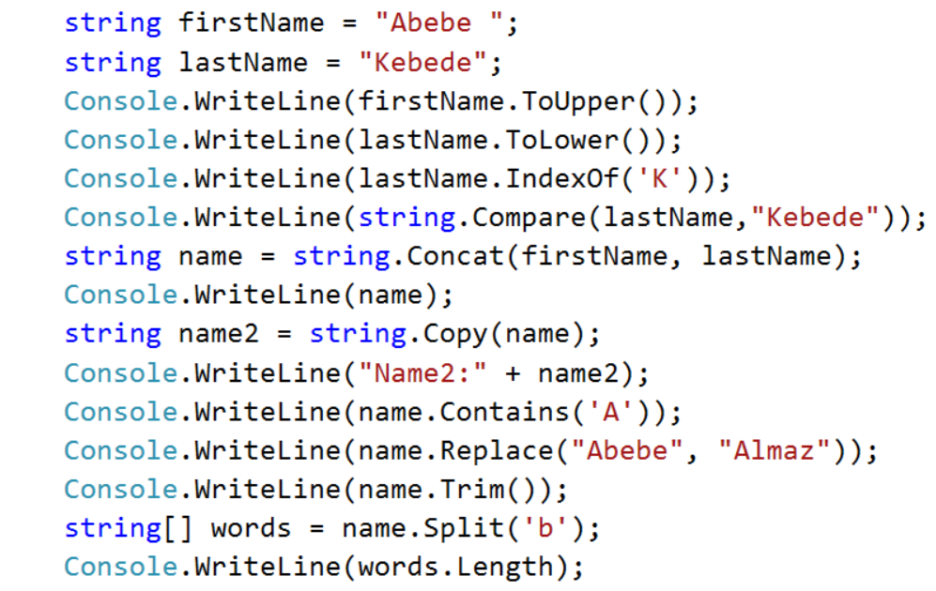
Example

Slide 31
StringBuilder

Slide 32
StringBuilder explained
String class has many capabilities for processing strings. However a string’s contents can never change – immutable.
Eg. Concatenation of string (+=) - create new string and assigns its reference to the variable.
Class StringBuilder - used to create and manipulate dynamic string information—i.e., mutable (changeable).
Every StringBuilder can store a certain number of characters that’s specified by its capacity. Exceeding the capacity of a StringBuilder causes the capacity to expand to accommodate the additional characters.
E.g concatenation method such as Append and AppendFormat – maintain without creating any new string objects.
StringBuilder is particularly useful for manipulating in place a large number of strings, as it’s much more efficient than creating individual immutable strings.

Slide 33
StringBuilder Constructors
Class StringBuilder provides six overloaded constructors.
E.g. var buffer1 = new StringBuilder(); // with default initial capacity
var buffer2 = new StringBuilder(10); //initial capacity spacified in int
var buffer3 = new StringBuilder("hello");// initialized with string content
Output of:
Console.WriteLine($"buffer1 = \"{buffer1}\""); // buffer1 = “ “

Slide 34
Length and Capacity Properties, EnsureCapacity Method and Indexer of Class StringBuilder
Property - Length and Capacity
Length - return the number of characters currently in a StringBuilder, and
Capacity – return the number of characters that a StringBuilder can store without allocating more memory.
used to increase or decrease the length or the capacity of the StringBuilder.
Method - EnsureCapacity
allows to reduce the number of times that a StringBuilder’s capacity must be increased.
The method ensures that the StringBuilder’s capacity is at least the specified value.

Slide 35
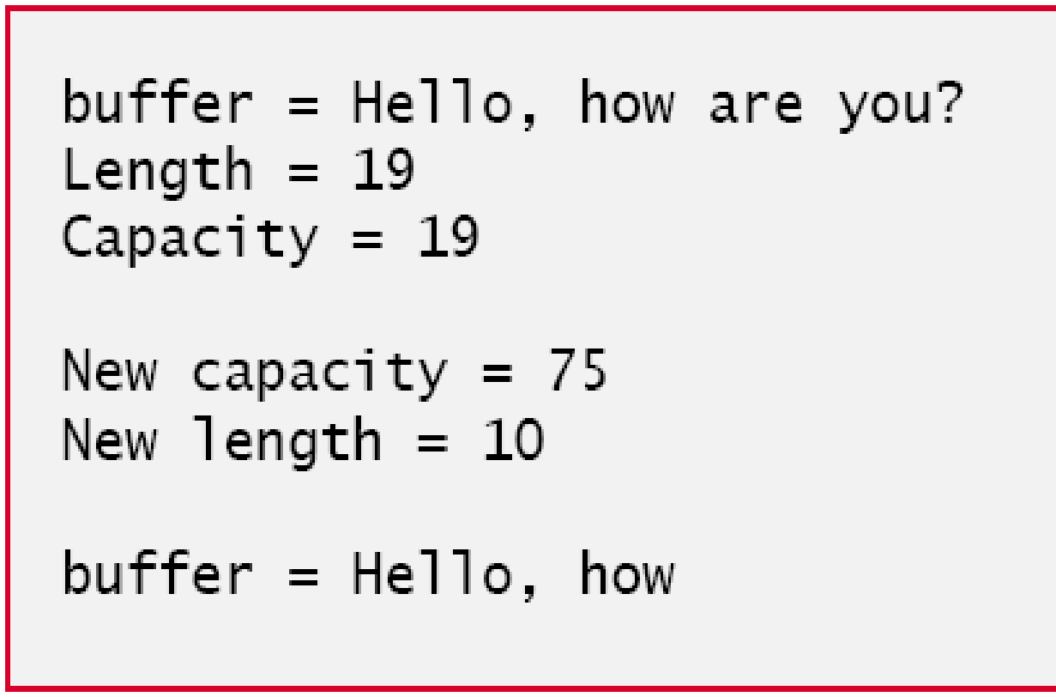
var buffer = new StringBuilder("Hello, how are you?");
// use Length and Capacity properties
Console.WriteLine($"buffer = {buffer}" + $"\nLength = { }" + $"\nCapacity = { }");
buffer.EnsureCapacity(75);
Console.WriteLine($"\nNew capacity = { }");
// truncate StringBuilder by setting Length property
buffer.Length=10;
Console.Write($"New length = { buffer.Length}\n\nbuffer = "); // use StringBuilder indexer
for (int i = 0; i < ; ++i)
{
Console.Write(buffer[i] );
} Console.WriteLine();

Slide 36
Append and AppendFormat Methods of Class StringBuilder
Class StringBuilder provides overloaded Append methods that allow various types of values to be added to the end of a StringBuilder.
The Framework Class Library provides versions for each simple type and for character arrays, strings and objects. (Remember that method ToString produces a string representation of any object.)
Each method takes an argument, converts it to a string and appends it to the StringBuilder.

Slide 37
object objectValue = "hello";
var stringValue = "good bye";
char[] characterArray = {'a', 'b', 'c', 'd', 'e', 'f'};
var booleanValue = true;
var characterValue = 'Z';
var integerValue = 7;
var longValue = 1000000L; // L suffix indicates a long literal
var floatValue = 2.5F; // F suffix indicates a float literal
var doubleValue = 33.333;
var buffer = new StringBuilder();
// use method Append to append values to buffer
buffer.Append(objectValue); buffer.Append(" ");
buffer.Append(stringValue); buffer.Append(" ");
buffer.Append(characterArray); buffer.Append(" ");
buffer.Append(characterArray, 0, 3); buffer.Append(" ");
buffer.Append(booleanValue); buffer.Append(" ");
buffer.Append(characterValue); buffer.Append(" ");
buffer.Append(integerValue); buffer.Append(" ");
buffer.Append(longValue); buffer.Append(" ");
buffer.Append(floatValue); buffer.Append(" ");
buffer.Append(doubleValue);
Console.WriteLine($"buffer = {buffer.ToString()}");

Slide 38
Insert, Remove and Replace Methods of Class StringBuilder
Class StringBuilder provides overloaded Insert methods
to allow various types of data to be inserted at any position in a StringBuilder.
The class provides versions for each simple type and for character arrays, strings and objects.
Each method takes its second argument, converts it to a string and inserts the string into the StringBuilder in front of the character in the position specified by the first argument.
The index specified by the first argument must be greater than or equal to 0 and less than the StringBuilder’s length; otherwise, the program throws an ArgumentOutOfRangeException.

Slide 39
Cont.
Class StringBuilder also provides method Remove for deleting any portion of a StringBuilder.
Method Remove takes two arguments—the index at which to begin deletion and the number of characters to delete.
The sum of the starting index and the number of characters to be deleted must always be less than the StringBuilder’s length; otherwise, the program throws an ArgumentOutOfRangeException.

Slide 40


The Insert and Remove methods are demonstrated
buffer.Insert(0, objectValue); buffer.Insert(0, " ");
buffer.Insert(0, stringValue); buffer.Insert(0, " ");
buffer.Insert(0, characterArray); buffer.Insert(0, " ");
buffer.Insert(0, booleanValue); buffer.Insert(0, " ");
buffer.Insert(0, characterValue); buffer.Insert(0, " ");
buffer.Insert(0, integerValue); buffer.Insert(0, " ");
buffer.Insert(0, longValue); buffer.Insert(0, " ");
buffer.Insert(0, floatValue); buffer.Insert(0, " ");
buffer.Insert(0, doubleValue); buffer.Insert(0, " ");
Console.WriteLine($"buffer after Inserts: \n{buffer}\n");
buffer.Remove(10, 1); // delete 2 in 2.5
buffer.Remove(4, 4); // delete .333 in 33.333
Console.WriteLine($"buffer after Removes:\n{buffer}");
object objectValue = "hello";
var stringValue = "good bye";
char[] characterArray = {'a', 'b', 'c', 'd', 'e', 'f'};
var booleanValue = true;
var characterValue = 'K';
var integerValue = 7;
var longValue = 1000000L; // L suffix indicates a long literal
var floatValue = 2.5F; // F suffix indicates a float literal
var doubleValue = 33.333;
var buffer = new StringBuilder();

Slide 41
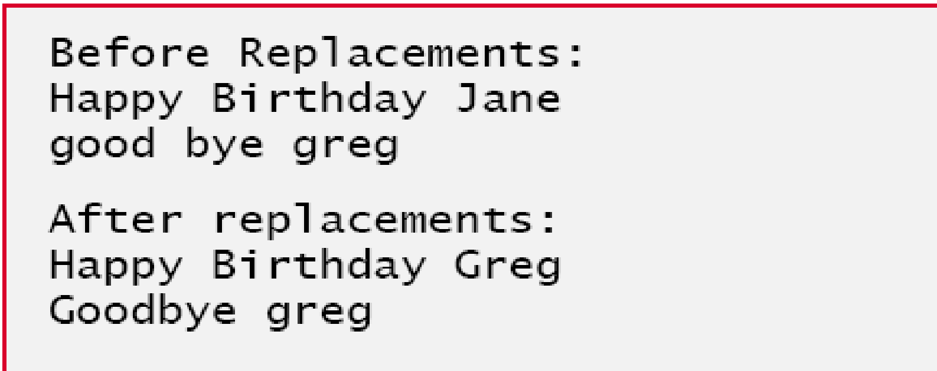
Another useful method included with StringBuilder is Replace, which searches for a specified string or character and substitutes another string or character all occurrences.
var builder1 = new StringBuilder("Happy Birthday Jane");
var builder2 = new StringBuilder("goodbye greg");
Console.WriteLine($"Before replacements:\n{builder1}\n{builder2}");
builder1.Replace("Jane", "Greg");
builder2.Replace('g', 'G', 0, 5);//replace g by G if the char is found in the index specified i.e. 0 - 5
Console.WriteLine($"\nAfter replacements:\n{builder1}\n{builder2}");

Slide 42
Regular Expressions
Define Regular Expression(RegEx)
Applications of RegEx
How to design a RegEx expression

Slide 43
RegEx Explained
Regular expressions are specially formatted strings used to find patterns in text and can be useful during information validation, to ensure that data is in a particular format.
Regular expressions provide a powerful, flexible, and efficient method for processing text.
There are numerous applications of Regular Expressions

Slide 44
Applications of RegEx
Compiler
RegEx facilitate the construction of a compiler. a large and complex regular expression is used to validate the syntax of a program.If the program code does not match the regular expression, the compiler knows that there is a syntax error within the code.
Input Validation: Validate text to ensure that it matches a predefined pattern (such as an email address).
Find specific character patterns.
Extract, edit, replace, or delete text substrings.
Add extracted strings to a collection in order to generate a report.

Slide 45
Other real life applications of RegEx
Extracting emails from a document: A lot of times, the sales and marketing teams might require finding/extracting emails and other contact information from large text documents.
Regular Expressions for Web Scraping (Data Collection): One can simply scrape websites like Wikipedia etc. to collect/generate data. But web scraping has its own issues –the downloaded data is usually messy and full of noise. This is where Regex can be used effectively.
Working with Date-Time features: regex enables you to work with different date formats
Using Regex for Text Pre-processing (NLP): removing inconsistent data when working with data collected either manually or web scraped data.

Slide 46
How do we design apps with RegEx
The centerpiece of text processing with regular expressions is the regular expression engine, which is represented by the System.Text.RegularExpressions.Regex object in .NET.
Processing text using regular expressions requires that the regular expression engine be provided with the following two items of information:
The regular expression pattern to identify in the text.
The text to parse for the regular expression pattern.

Slide 47
Cont.
The .NET Framework provides several classes to help developers recognize and manipulate regular expressions.
Class Regex (System.Text.RegularExpressions namespace) represents an immutable regular expression.

Slide 48
Methods in Regex
Class Regex – represent an immutable regular expression. Contains static methods - such as
Match() that returns an object of class Match (represents a single regular expression match).
Matches() finds all matches of a regluar expression in an arbitrary string and returns a MatchCollection object (set of Matches).
IsMatch() Indicates whether the regular expression specified in the Regex constructor finds a match in the specified input string
Other methods include Replace() Split()

Slide 49
Examples: Using RegEx Method Replace ()
string pattern = @"(Mr\.? |Mrs\.? |Miss |Ms\.? )";
string[] names = { "Mr. Henry Hunt", "Ms. Sara Samuels", "Abraham Adams", "Ms. Nicole Norris" };
foreach (string name in names) {Console.WriteLine(Regex.Replace(name, pattern, String.Empty)); }
Output
Henry Hunt
Sara Samuels
Abraham Adams
Nicole Norris

Slide 50
Method Replace() and Split() of Regex
Regex class provides static and instance versions of methods Replace and Split.
Replace() – is useful to replace parts of a string with another, and,
Split() – is useful to split a string according to a regular expression.

Slide 51
Replace() method
Method Replace replaces text in a string with new text wherever the original string matches a regular expression. It has two version – static and instance method
Static version of Replace()
Takes three parameters—the string to modify, the string containing the regular expression to match and the replacement string.
Replace replaces every instance of "*" in testString1 with "^".
Notice the regular expression (@"\*") precedes character * with a backslash, \.
Normally, * is a quantifier indicating that a regular expression should match any number of occurrences of a preceding pattern.

Slide 52
Using Replace() instance method that uses the regular expression passed to the constructor for testRegex1 to perform the replacement operation. In this case, every match for the regular expression "stars" in testString1 is replaced with "carets".

Slide 53
Use of instance method Replace() to

Slide 54
Split() method of Regex
Method Split divides a string into several substrings. The original string is broken in any location that matches a specified regular expression.
Method Split returns an array containing the substrings between matches for the regular expression.
We use the static version of method Split to separate a strings that are -separated by comma.

Slide 55
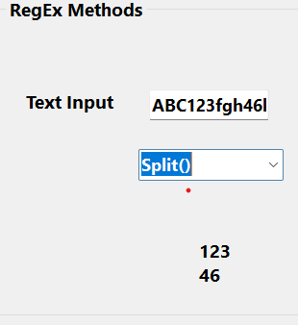
Demo App
private void comboBox1_SelectedIndexChanged(object sender, EventArgs e)
{
textBox1.Text = "ABC123fgh46koli";
string pattern = "[a-zA-Z]+";
string[] result = Regex.Split(textBox1.Text, pattern);
foreach (string s in result)
{
label11.Text += s + "\n";
}

Slide 56
Elements of a RegEx
A character class is an escape sequence that represents a group of characters.
A word character is any alphanumeric character or underscore.
A whitespace character is a space, a tab, a carriage return, a newline or a form feed.
A digit is any numeric character.

Slide 57
\-> Marks the next character as either a special character or escapes a literal. For example, "n" matches the character "n". "\n" matches a newline character. The sequence "\\" matches "\" and "\(" matches "(".
^ -> first character in a string(starts with)
$-> ends with
* -> Matches the preceding character zero or more times. For example, "zo*" matches either "z" or "zoo".
+ -> Matches the preceding character one or more times. For example, "zo+" matches "zoo" but not "z".
? -> Matches the preceding character zero or one time. For example, "a?ve?" matches the "ve" in "never".
. ->Matches any single character except a newline character.

Slide 58
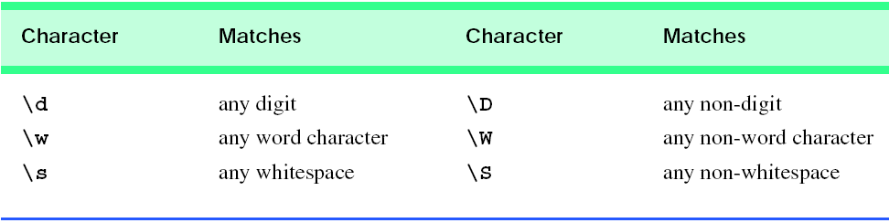
Elements of RegularExpressions
[abc] a,b or c
[a-z] a to z
[A-Z] A to Z
[a-zA-z] a to z A to Z
[0-9] digits 0 to 9

Slide 59
Quantifiers of RegEx
[ ]? 0 or 1 time
[]+ occurs one or more time
[]* occurs zero or more time
[]{n} occurs n times
[]{n,m} occurs in the range of n to m

Slide 60
Exercise on Regex
Enter a character between a and z
[a-z]
Enter a character between a and z and with length of 2
[a-z]{2}
Enter a character between a and z and with length spanning from 1 up to 3
[a-z]{1,3}
Validate data with 8 digits fixed format
[\d]{8}

Slide 61
Cont.
Validate invoice number that has the following format the first three are characters followed by 8 digits

Slide 62
READING ASSIGNMENT
COMPARING STRINGS USING (==)
Extract the numbers from date formats
Sort array of strings in alphabetical order

